Slide 1
Chapter 2: Advanced Web Development Concepts

Slide 2
Learning Objectives
What is SASS?
CSS and SASS
Interactivity using Javascript
Javascript basics
JQuery
AJAX

Slide 3
What is SASS?
Sass is a scripting language that is interpreted or compiled into Cascading Style Sheets (CSS).
SassScript is the scripting language itself. Sass consists of two syntaxes. The original syntax, called "the indented syntax", uses a syntax similar to Haml.
It uses indentation to separate code blocks and newline characters to separate rules. The newer syntax, "SCSS", uses block formatting like that of CSS. It uses braces to denote code blocks and semicolons to separate lines within a block.
The indented syntax and SCSS files are traditionally given the extensions .sass and .scss, respectively.
CSS3 consists of a series of selectors and pseudo-selectors that group rules that apply to them. Sass (in the larger context of both syntaxes) extends CSS by providing several mechanisms available in more traditional programming languages, particularly object-oriented languages, but that are not available to CSS3 itself.
When SassScript is interpreted, it creates blocks of CSS rules for various selectors as defined by the Sass file. The Sass interpreter translates SassScript into CSS. Alternatively, Sass can monitor the .sass or .scss file and translate it to an output .css file whenever the .sass or .scss file is saved.
Sass is simply syntactic sugar for CSS.
You can install SASS by visting: http://sass-lang.com/install

Slide 4
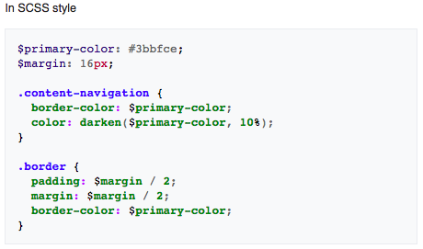
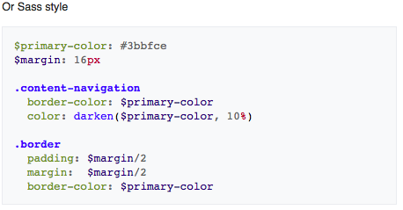
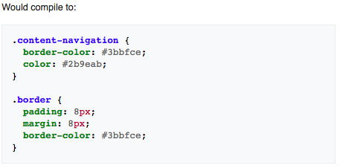
SASS and CSS: Variables

Slide 5
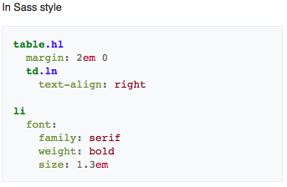
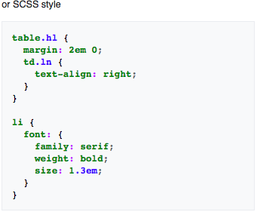
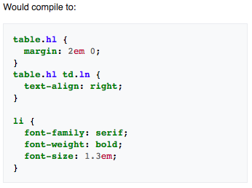
SASS and CSS: Nesting

Slide 6
What is JavaScript, really?
JavaScript is a programming language that adds interactivity to your website (for example: games, responses when buttons are pressed or data entered in forms, dynamic styling, animation).
JavaScript ("JS" for short) is a full-fledged dynamic programming language that, when applied to an HTML document, can provide dynamic interactivity on websites. It was invented by Brendan Eich, co-founder of the Mozilla project.
JavaScript is incredibly versatile. You can start small, with carousels, image galleries, fluctuating layouts, and responses to button clicks. With more experience, you'll be able to create games, animated 2D and 3D graphics, comprehensive database-driven apps, and much more!
It is fairly compact yet very flexible. Developers have written a large variety of tools on top of the core JavaScript language, unlocking a vast amount of extra functionality with minimum effort. These include:
Browser Application Programming Interfaces (APIs) — APIs built into web browsers, providing functionality like dynamically creating HTML and setting CSS styles, collecting and manipulating a video stream from the user's webcam, or generating 3D graphics and audio samples.
Third-party APIs to allow developers to incorporate functionality in their sites from other content providers, such as Twitter or Facebook.
Third-party frameworks and libraries you can apply to your HTML to allow you to rapidly build up sites and applications.

Slide 7
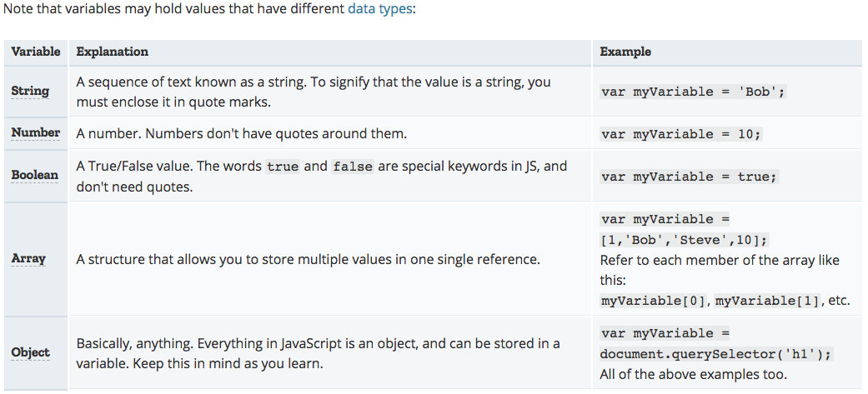
Language basics crash course: Variables
Variables: are containers that you can store values in. You start by declaring a variable with the var keyword, followed by any name you want to call it. After declaring a variable, you can give it a value. You can do both these operations on the same line if you wish. You can retrieve the value by just calling the variable by name. After giving a variable a value, you can later choose to change it.

Slide 8
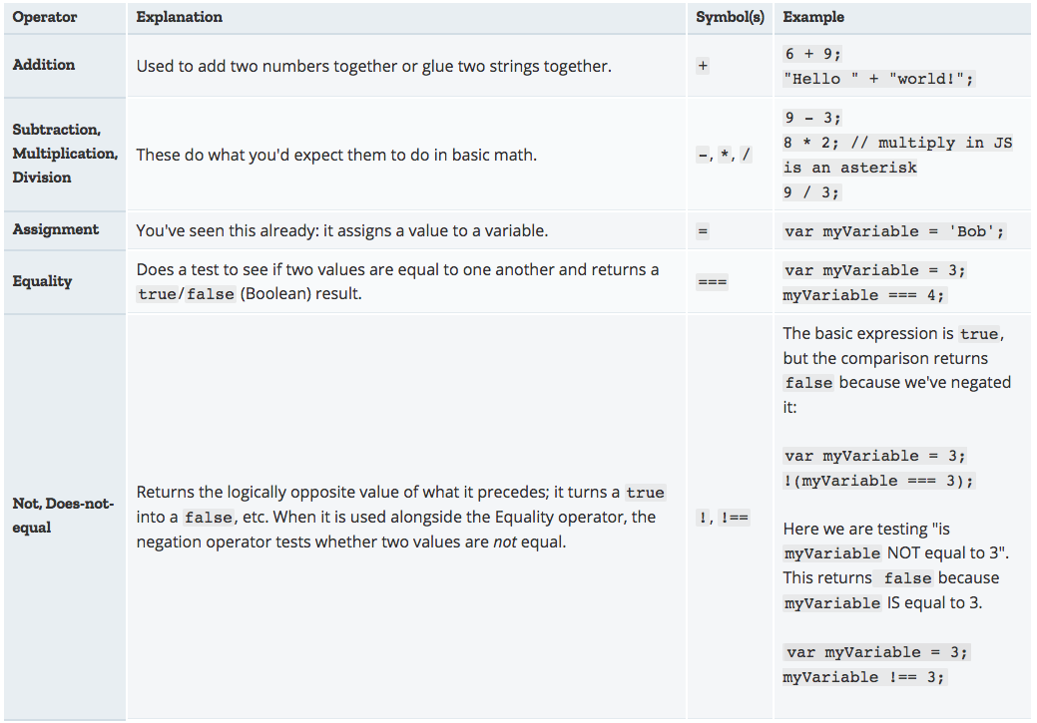
Language basics crash course: Operators
An operator is a mathematical symbol which produces a result based on two values (or variables). In the following table you can see some of the simplest operators, along with some examples to try out in the JavaScript console.

Slide 9
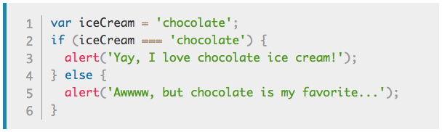
Language basics crash course: Conditionals
Conditionals are code structures which allow you to test if an expression returns true or not, running alternative code revealed by its result. A very common form of conditionals is the if ... else statement. For example:
The expression inside the if ( ... ) is the test — this uses the identity operator (as described above) to compare the variable iceCream with the string chocolate to see if the two are equal. If this comparison returns true, the first block of code is run. If the comparison is not true, the first block is skipped and the second code block, after the else statement, is run instead.

Slide 10


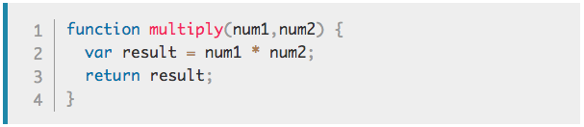
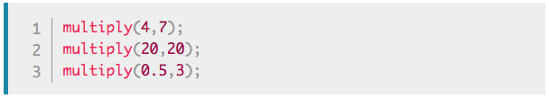
Language basics crash course: Functions
Functions are a way of packaging functionality that you wish to reuse. When you need the procedure you can call a function, with the function name, instead of rewriting the entire code each time. You have already seen some uses of functions above, for example:
You can define your own functions — in this next example we write a simple function which takes two numbers as arguments and multiplies them:

Slide 11
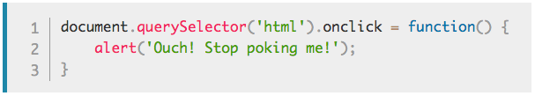
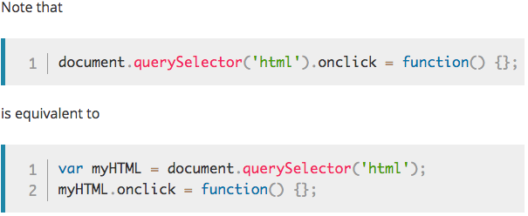
Language basics crash course: Events
Real interactivity on a website needs events. These are code structures which listen for things happening in browser, running code in response. The most obvious example is the click event, which is fired by the browser when you click on something with your mouse. To demonstrate this, enter the following into your console, then click on the current webpage:
There are many ways to attach an event to an element. Here we select the <html> element, setting its onclick handler property equal to an anonymous (i.e. nameless) function, which contains the code we want the click event to run.

Slide 12
What is jQuery?
jQuery is a fast and concise JavaScript Library created by John Resig in 2006 with a nice motto: Write less, do more. jQuery simplifies HTML document traversing, event handling, animating, and Ajax interactions for rapid web development. jQuery is a JavaScript toolkit designed to simplify various tasks by writing less code. Here is the list of important core features supported by jQuery
DOM manipulation − The jQuery made it easy to select DOM elements, negotiate them and modifying their content by using cross-browser open source selector engine called Sizzle.
Event handling − The jQuery offers an elegant way to capture a wide variety of events, such as a user clicking on a link, without the need to clutter the HTML code itself with event handlers.
AJAX Support − The jQuery helps you a lot to develop a responsive and feature rich site using AJAX technology.
Animations − The jQuery comes with plenty of built-in animation effects which you can use in your websites.
Lightweight − The jQuery is very lightweight library - about 19KB in size (Minified and gzipped).
Cross Browser Support − The jQuery has cross-browser support, and works well in IE 6.0+, FF 2.0+, Safari 3.0+, Chrome and Opera 9.0+

Slide 13

What’s $, anyway?
The jQuery library provides the jQuery function, which lets you select elements using CSS selectors.
The $ in the code above is just a shorter, more convenient name for the jQuery function; indeed, in the jQuery source code, you'll find this near the end:
When you call the $() function and pass a selector to it, you create a new jQuery object.
Of course, in JavaScript, functions are objects too, so that means that $ (and jQuery, of course) has properties and methods, too.
For example, you can refer to the $.support property for information on what the current browser environment supports, and you use the $.ajax method to make an AJAX request.
Before you can safely use jQuery to do anything to your page, you need to ensure that the page is in a state where it's ready to be manipulated. With jQuery, we accomplish this by putting our code in a function, and then passing that function to $(document).ready().

Slide 14
jQuery Selectors
jQuery selectors allow you to select and manipulate HTML element(s).
jQuery selectors are used to "find" (or select) HTML elements based on their name, id, classes, types, attributes, values of attributes and much more. It's based on the existing CSS Selectors, and in addition, it has some own custom selectors.
All selectors in jQuery start with the dollar sign and parentheses: $() – which is the global jQuery function.
The following are the jQuery selectors you can use:
The element Selector: Finds elements by HTML tag. E.g.: $(“body”) or $(“button”) etc.
The #id Selector: Finds elements by ID. E.g.: $(“#topSection”) or $(“#menuBar”) etc.
The .class Selector: Finds elements with a specific class. E.g.: $(“.listItems”) etc.
You can combine the above fundamental selectors and create more sophisticated selectors using them.
Selectors are starting point for performing DOM manipulations using jQuery.
The next section shows some examples showing the usage of jQuery selectors to find elements of a wide variety.

Slide 15
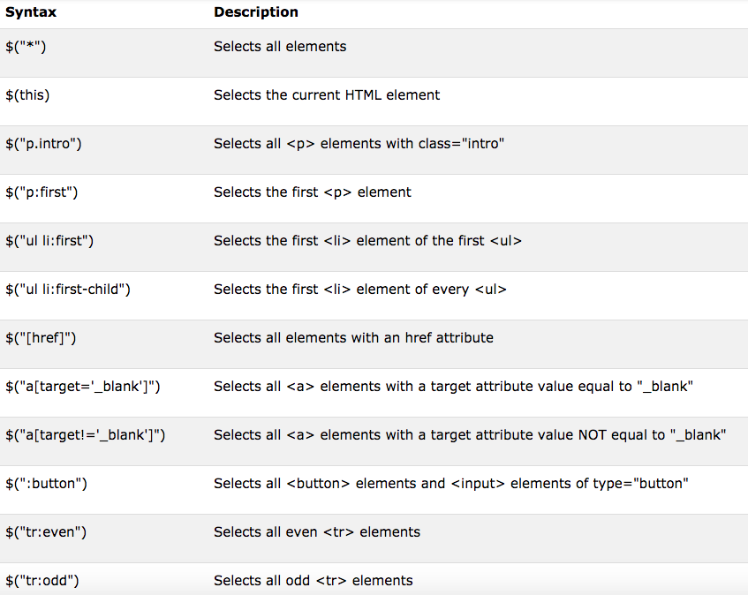
jQuery Selectors

Slide 16
jQuery Selectors
Function | Description
after(content) | Insert content after each of the matched elements.
append( content ) | Append content to the inside of every matched element.
appendTo( selector ) | Append all of the matched elements to another, specified, set of elements.
before( content ) | Insert content before each of the matched elements.
clone( bool ) | Clone matched DOM Elements, and all their event handlers, and select the clones.
clone( ) | Clone matched DOM Elements and select the clones.
empty( ) | Remove all child nodes from the set of matched elements.
html( val ) | Set the html contents of every matched element.
html( ) | Get the html contents (innerHTML) of the first matched element.
insertAfter( selector ) | Insert all of the matched elements after another, specified, set of elements.
insertBefore( selector ) | Insert all of the matched elements before another, specified, set of elements.
prepend( content ) | Prepend content to the inside of every matched element.
prependTo( selector ) | Prepend all of the matched elements to another, specified, set of elements.
remove( expr ) | Removes all matched elements from the DOM.
replaceAll( selector ) | Replaces the elements matched by the specified selector with the matched elements.
replaceWith( content ) | Replaces all matched elements with the specified HTML or DOM elements.
text( val ) | Set the text contents of all matched elements.
text( ) | Get the combined text contents of all matched elements.
wrap( elem ) | Wrap each matched element with the specified element.
wrap( html ) | Wrap each matched element with the specified HTML content.
wrapAll( elem ) | Wrap all the elements in the matched set into a single wrapper element.
wrapAll( html ) | Wrap all the elements in the matched set into a single wrapper element.
wrapInner( elem ) | Wrap the inner child contents of each matched element (including text nodes) with a DOM element.
wrapInner( html ) | Wrap the inner child contents of each matched element (including text nodes) with an HTML structure.

Slide 17
JQuery AJAX Methods
Function | Description
jQuery.ajax( options ) | Load a remote page using an HTTP request.
jQuery.ajaxSetup( options ) | Setup global settings for AJAX requests.
jQuery.get( url, [data], [callback], [type] ) | Load a remote page using an HTTP GET request.
jQuery.getJSON( url, [data], [callback] ) | Load JSON data using an HTTP GET request.
jQuery.getScript( url, [callback] ) | Loads and executes a JavaScript file using an HTTP GET request.
jQuery.post( url, [data], [callback], [type] ) | Load a remote page using an HTTP POST request.
load( url, [data], [callback] ) | Load HTML from a remote file and inject it into the DOM.
serialize( ) | Serializes a set of input elements into a string of data.
serializeArray( ) | Serializes all forms and form elements like the .serialize() method but returns a JSON data structure for you to work with.
JQuery AJAX Events
Event | Description
ajaxComplete( callback ) | Attach a function to be executed whenever an AJAX request completes.
ajaxStart( callback ) | Attach a function to be executed whenever an AJAX request begins and there is none already active.
ajaxError( callback ) | Attach a function to be executed whenever an AJAX request fails.
ajaxSend( callback ) | Attach a function to be executed before an AJAX request is sent.
ajaxStop( callback ) | Attach a function to be executed whenever all AJAX requests have ended.
ajaxSuccess( callback ) | Attach a function to be executed whenever an AJAX request completes successfully.

Slide 18
Thank You !

